Slide 1
Stateful widget
Prepared by Amira Nasser
amira20nasser@gmail.com
Amira Nasser | Facebook
LinkedIn
Notes:
Revise the Task and tell them what’s better to do this task

Slide 2
Agenda
01
02
03
04
Stateless Widget life cycle
Stateful Widget life cycle
Overview UI
Let’s code together

Slide 3
01
Stateless Widget life cycle
Notes:
أي حاجه في فلاتر عبارة عن ويدجت طب أي أنواع ويدجت عندنا stateless & stateful extends منها طيب stateless أي elements constructor – Build method
Stateful? createState(), initState(), didChangeDependencies(), build(), setState(), deactivate(), and dispose()

Slide 4
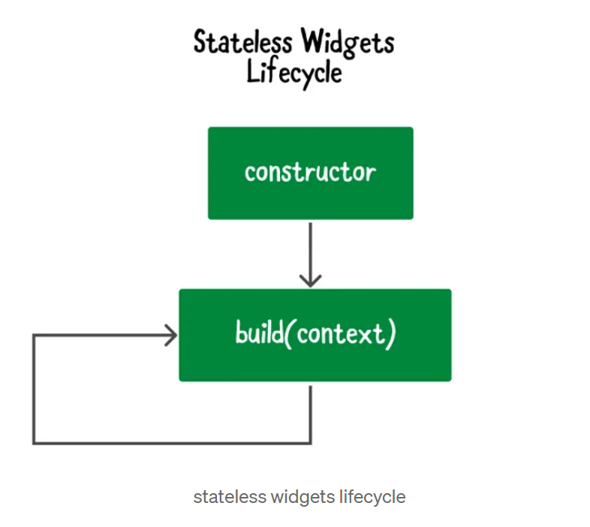
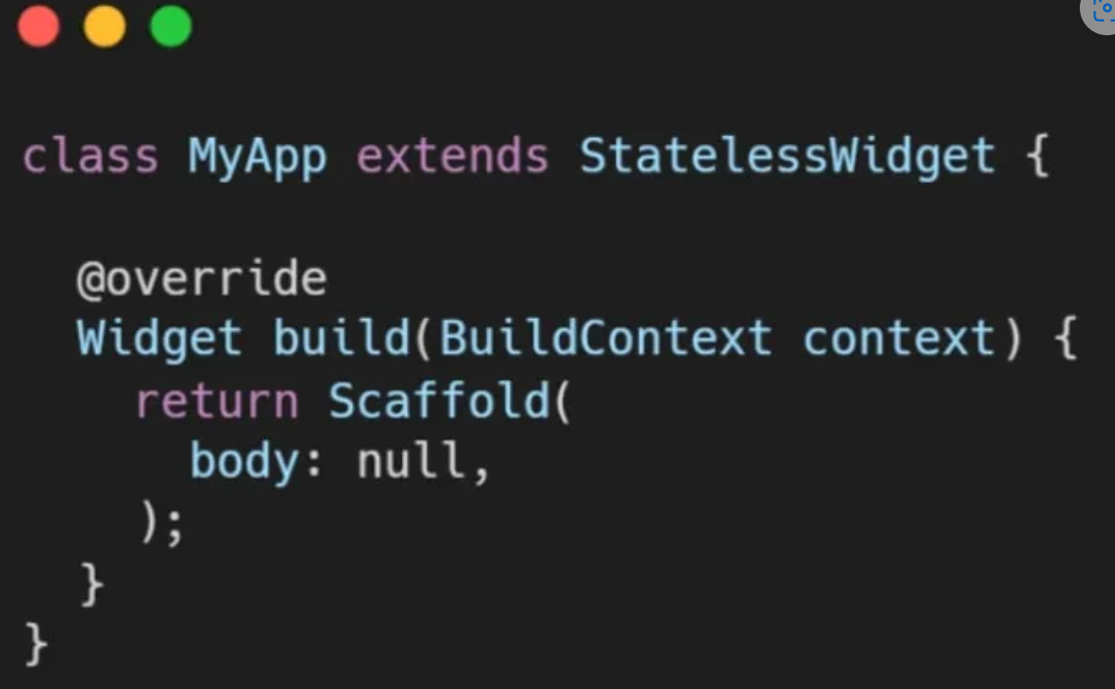

Slide 5
02
Stateful Widget life cycle

Slide 6
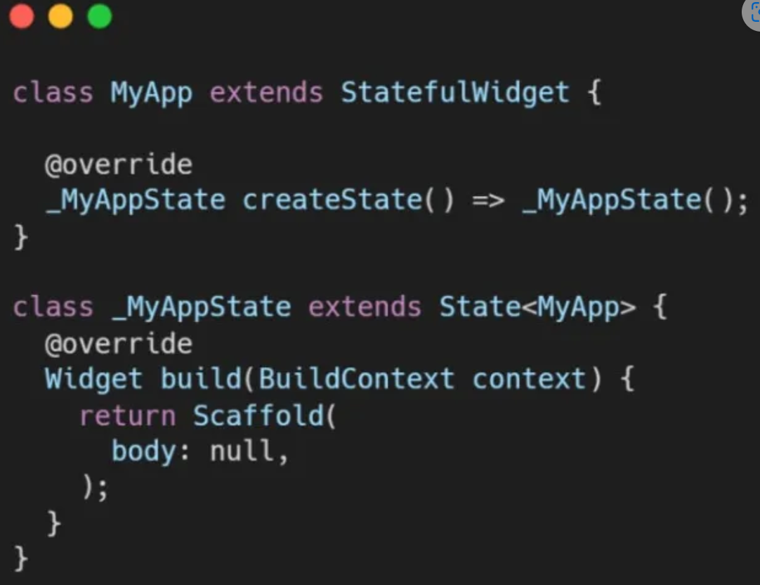

Slide 7
- createState(): When call to build a StatefulWidget, it calls
- initState()
- build(): This strategy is often used. It must return a Widget, and it is necessary.
Notes:
1-createState(): When call to build a StatefulWidget, it calls
2- initState()
3-didChangeDependencies() 4-build(): This strategy is often used. It must return a Widget, and it is necessary.
5-didUpdateWidget(): is called if the parent widget changes and has to rebuild this widget (because it needs to provide it different data), but the runtime type remains the same. This is due to the fact that Flutter is reusing a long-lived state. You might wish to re-initialize some data in this situation, as you would in initState.
6-deactivate(): is called when State is removed from the tree, although it might be reinserted before the current frameshift is complete. Because State objects may be transferred from one place in a tree to another, this technique exists.

Slide 8
03
Overview UI

Slide 9
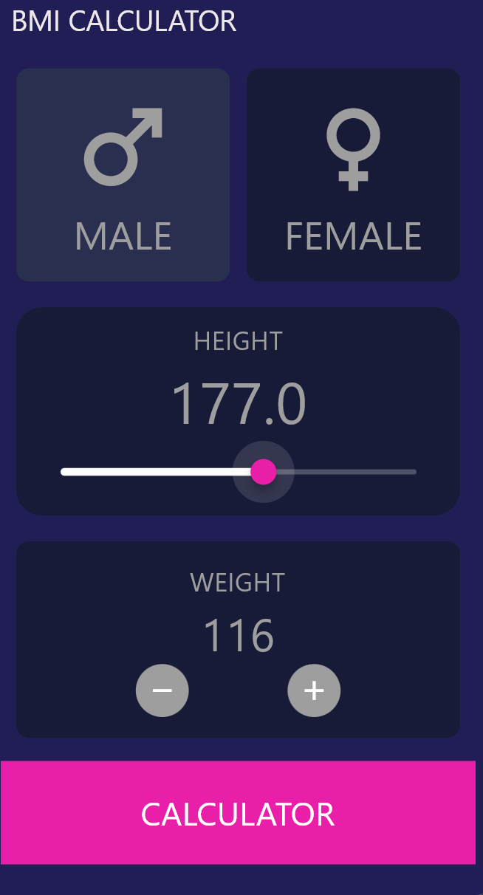

Slide 10
04
Let’s code

Slide 11
Thanks !
amira20nasser@gmail.com
LinkedIn
Amira Nasser | Facebook
If you have any problem , send to me 😊

